Slide 1
Diabetic Retinopathy Classification from Retinal Images using Machine Learning Approach
Tareq Mahmud Indronil Bhattacharjee
Roll no : 1507089 Roll no : 1507105
Supervised by :
Mr. Al-Mahmud
Assistant Professor
Department of CSE, KUET.

Slide 2
Outline
Introduction
Objective
Motivation
Related Works
Methodology
Workflow
Results and Experimental Analysis
Discussions and Conclusion
References

Slide 3
Introduction
People with diabetes can have an eye disease called diabetic retinopathy.
It happens when high blood sugar levels cause damage to blood vessels in the retina.
It can damage the patient’s vision, even leads to blindness.
Our aim is to develop a system that will be able to identify patients with Diabetic Retinopathy from retinal colour fundus images.

Slide 4
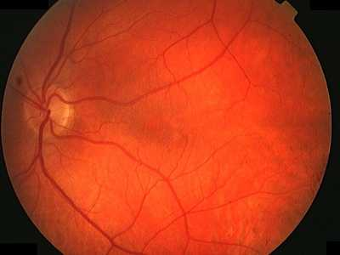
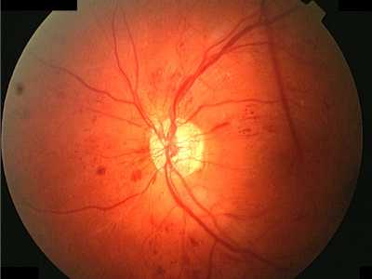
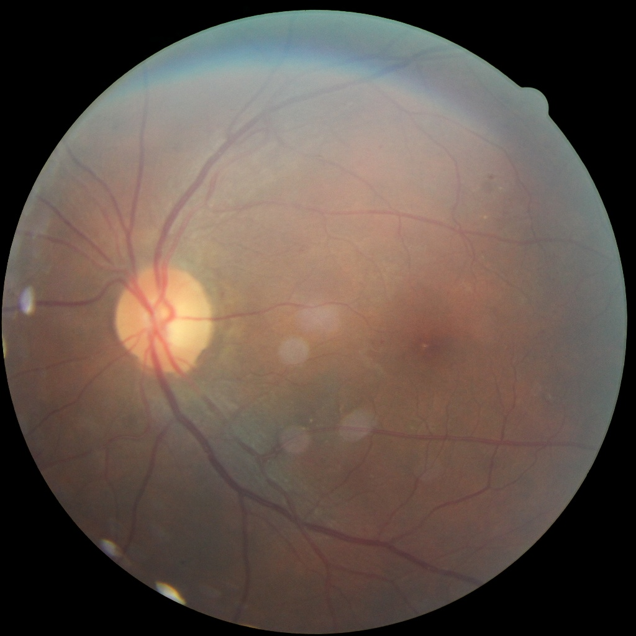
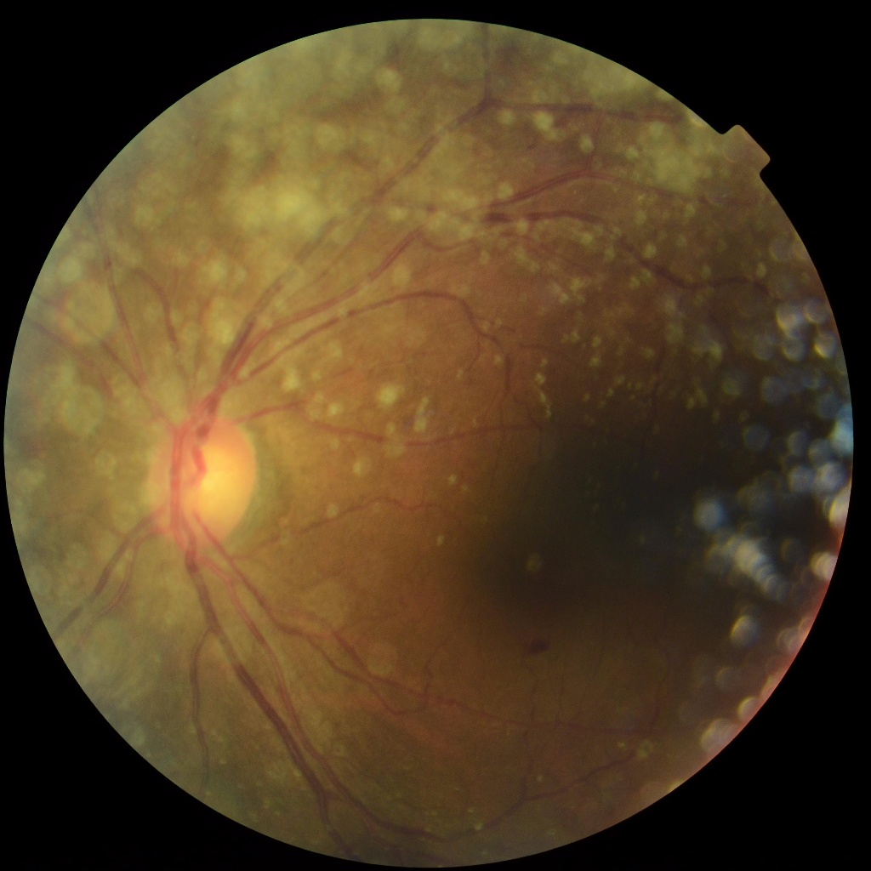
Introduction
(a) (b) (c)
(d) (e)
Fig 1 : (a) Healthy Eye (b) Mild NPDR (c) Moderate NPDR (d) Severe NPDR (e) PDR

Slide 5
Objective
Our objective is to -
Process colour fundus retinal images for Diabetic Retinopathy detection.
Extract key features from the pre-processed images.
Detect the presence of Diabetic Retinopathy.
Classify whether the Diabetic Retinopathy Mild, Moderate, Severe or Proliferative.

Slide 6
Motivation
Diabetic Retinopathy (DR) is one of the common eye diseases and is a diabetes complication that affects eyes.
Diabetic retinopathy may cause no symptoms or only mild vision problems. Eventually, it can cause blindness.
So early detection of symptoms could help to avoid blindness.

Slide 7
Related Works
Existing works performed DR detection using features of color fundus image like area and number of microaneurysm, exudates, appearance of haemorrhage etc.
Classification of DR has done by linear Naïve Bayes , SVM and NN classifiers.
Most of the works performed 2 and 3 class classifications. Whereas recent works like Acharya et al. had performed 5 class classification.

Slide 8
Methodology
Diabetic retinopathy detection system mainly consists three main steps:
Preprocessing of colour fundus images
Feature extraction
Classification of Diabetic Retinopathy

Slide 9
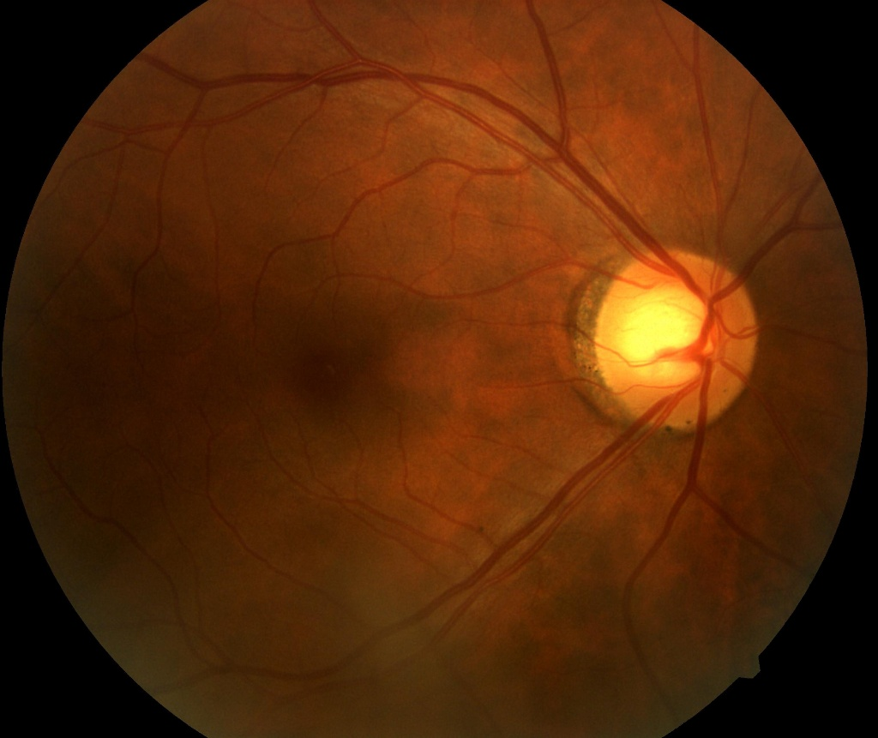
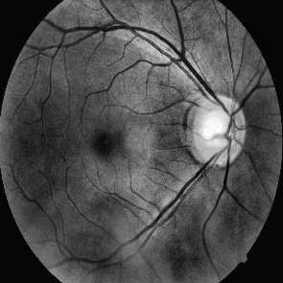
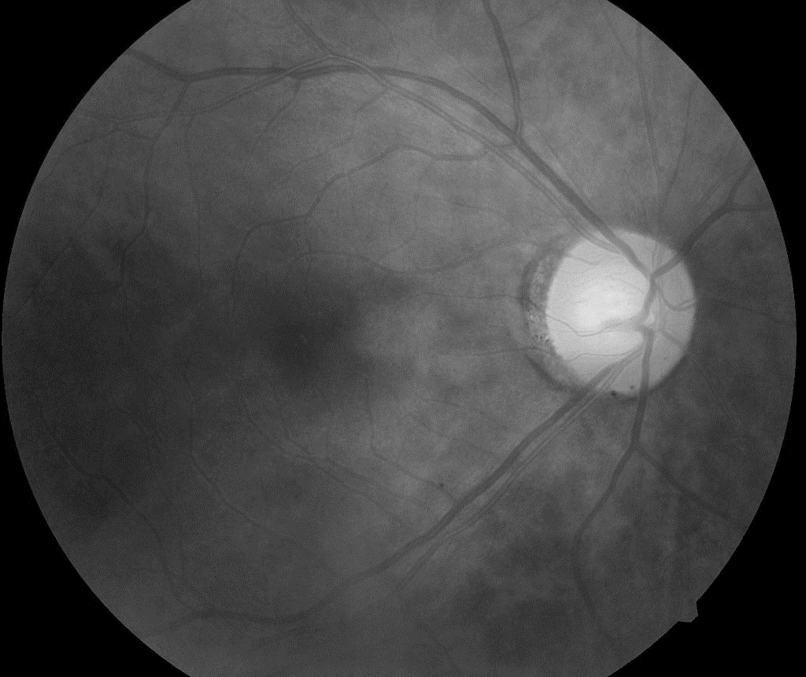
Preprocessing
General Preprocessing
(3) Contrast Limit Adaptive Histogram Equalization (CLAHE)
(1) Resizing
(2) Green Channel Extraction
350 x 350
1024 x 1024

Slide 10
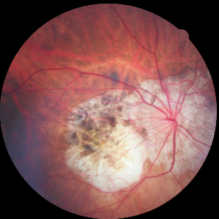
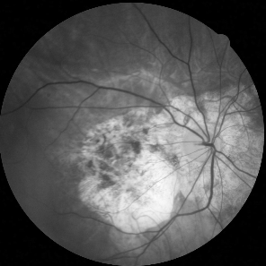
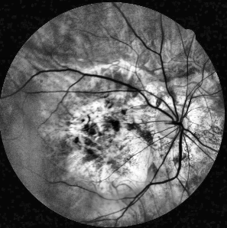
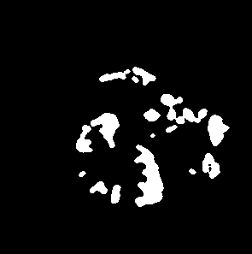
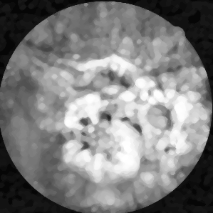
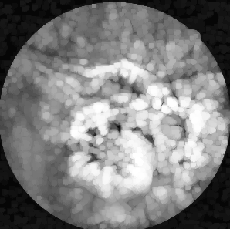
Preprocessing for Exudate Detection
(a) Input Image
(b) Green Channel
(c) CLAHE image
(f) After thresholding
(e) Median Filtered
(d) After Dilation

Slide 11
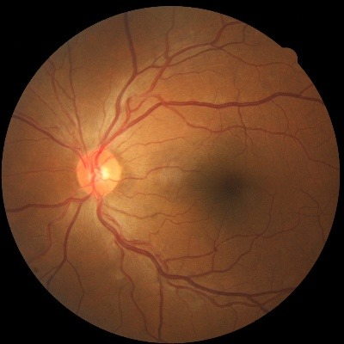
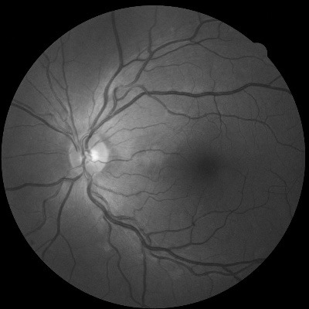
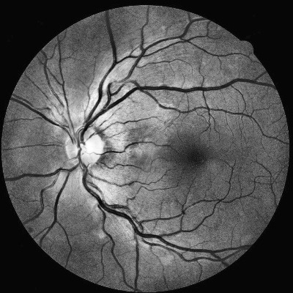
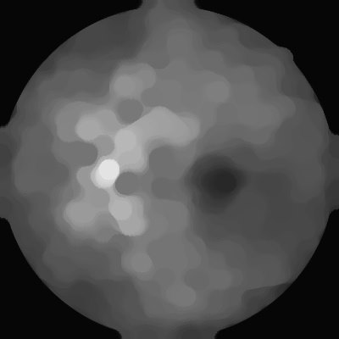
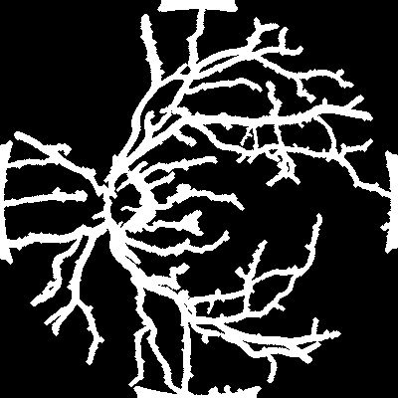
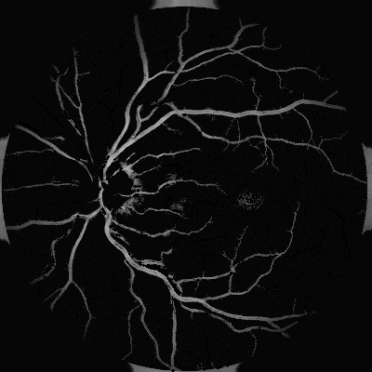
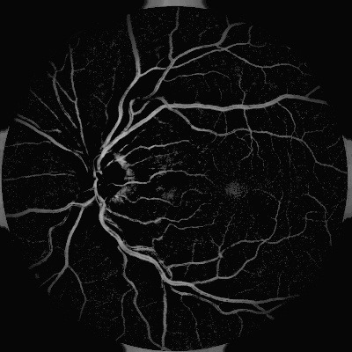
Preprocessing for Blood Vessel Detection
(d) Morphological closing and opening
(a) Input Image
(b) Green Channel
(c) CLAHE image
(g) After thresholding
(f) After Noise removal
(e) After subtraction

Slide 12
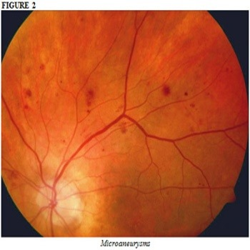
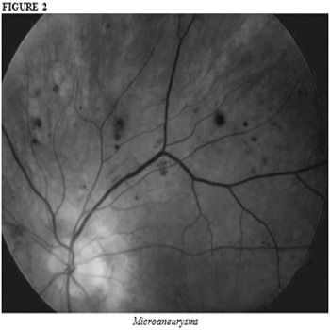
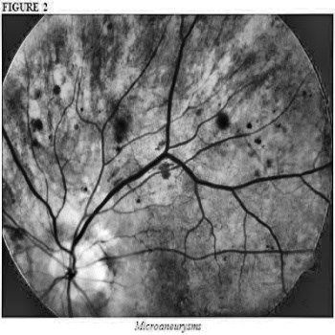
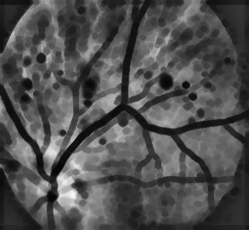
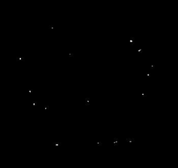
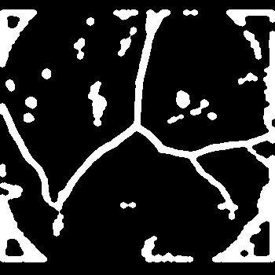
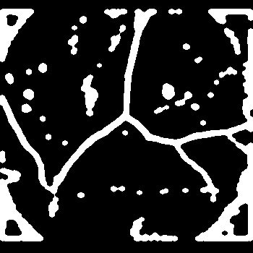
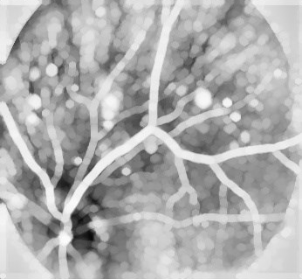
Preprocessing for Microaneurysm Detection
(a) Input Image
(b) Green Channel
(c) CLAHE image
(d) Morphological erosion
(h) After subtraction
(g) Small area removal
(f) After thresholding
(e) Inverted Image

Slide 13
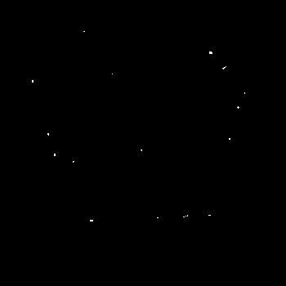
Feature Extraction
The features which are extracted to detect Diabetic Retinopathy are-
• Area of Exudates
• Area of Blood Vessel
• Area of Microaneurysms
Fig : Microaneurysms
Fig : Blood Vessel
Fig : Exudates

Slide 14
Classification
Classification is performed using Random Forest classifier.
It classifies five classes of Diabetic Retinopathy.
Five classes are labeled as-
0 : Normal Eye
1 : Mild NPDR
2 : Moderate NPDR
3 : Severe NPDR
4 : Proliferative DR

Slide 15
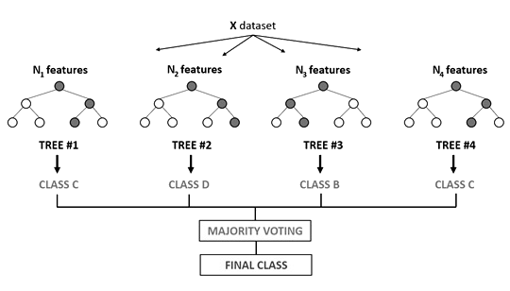
Random Forest Classifier
• Ensemble tree based learning algorithm.
• The fundamental concept behind random forest is a simple but powerful one - The wisdom of crowds.
• A large number of relatively uncorrelated trees operating as a committee will outperform any of the individual constituent models.
• Some trees may be wrong, many other trees will be right.
• As a group, the trees are able to move in the correct direction.

Slide 16
Classification (Continued)
Classifier parameters are fine tuned for the best performance.
Since random forest generates decision trees for prediction, several parameters are responsible for performance analysis.
Considering the features, we have used • No. of estimators = Number of trees in the forest = 3000
• Max_features = max number of features considered for splitting a node = Number of features
• Criterion = Gini index

Slide 17
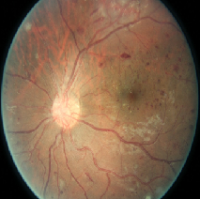
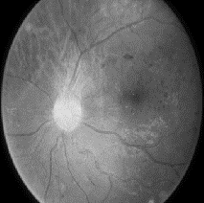
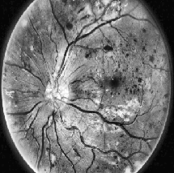
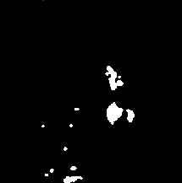
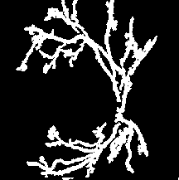
Workflow
Fundus Colour Image
Preprocessing
Optical Disk Removal
Exudates detection
Blood Vessels detection
Microaneurysm detection
Feature extraction
Intensity Histogram of Exudates
Zeroth hue moment of Exudates
Intensity Histogram of Blood Vessels
Zeroth hue moment of Blood Vessels
Intensity Histogram of Microaneurysms
Zeroth hue moment of Microaneurysms
[
]
[
]
[
]
Histogram of Exudates
Histogram of Blood Vessel
Histogram of Micro-
aneurysm
Random Forest Classifier
Classifier
Class 4
Healthy Eye
Mild
Moderate
Severe
PDR

Slide 18
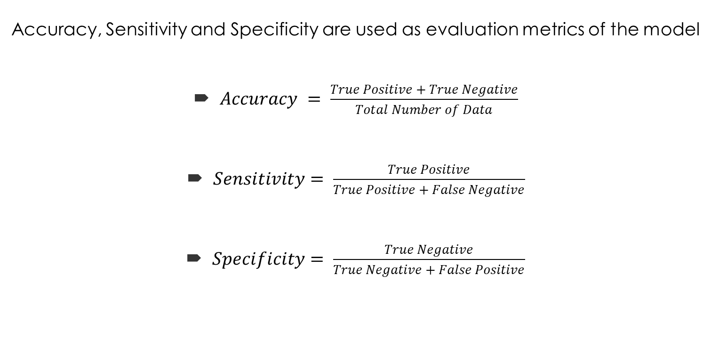
Evaluation Metrics
Accuracy, Sensitivity and Specificity are used as evaluation metrics of the model
$Accuracy = \frac{True Positive + True Negative}{Total Number of Data}$
$Sensitivity= \frac{True Positive}{True Positive + False Negative}$
$Specificity= \frac{True Negative}{True Negative + False Positive}$

Slide 19
Results and Experimental Analysis
• Confusion Matrix
Actual
 | Normal | Mild | Moderate | Severe | PDR
Normal | 989 | 100 | 114 | 63 | 66
Mild | 116 | 466 | 10 | 6 | 6
Moderate | 122 | 10 | 492 | 8 | 10
Severe | 82 | 2 | 12 | 316 | 8
PDR | 40 | 4 | 14 | 4 | 291
Predicted

Slide 20
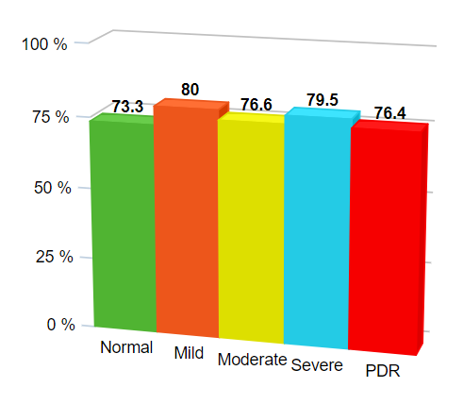
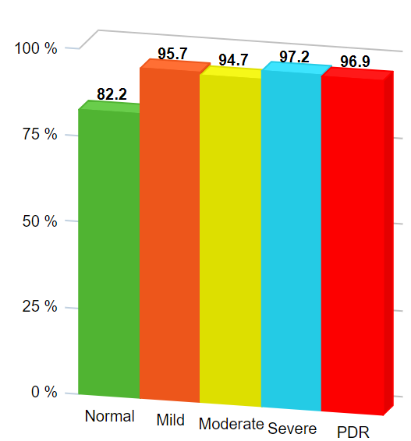
Results and Experimental Analysis (Continued)
Fig: Sensitivity Bar Diagram Fig: Specificity Bar Diagram
Average sensitivity of the classification = 77.2%
Average specificity of the classification = 93.3%
Accuracy of the classification = 76.5%

Slide 21
Comparison
• Comparison among Random Forest, SVM and Naïve Bayes
Metric Classifier | Accuracy | Sensitivity | Specificity
Random Forest | 76.5% | 77.2% | 93.3%
SVM | 47.4% | 48.1% | 61.3%
Naïve Bayes | 36.8% | 43.0% | 58.1%

Slide 22
Comparison
• Comparison with existing works
Criteria Work | Class | Features | Accuracy | Sensitivity | Specificity
Singalavanija et al. | 2 | 3 | Not reported | 74.8% | 82.7%
Kahai et al. | 2 | 1 | Not reported | 100% | 63%
Acharya et al. | 5 | 1 | 82% | 82.5% | 88.9%
Our work | 5 | 3 | 76.5% | 77.2% | 93.3%

Slide 23
Discussions and Conclusion
Accuracy comparison is done to get the best model.
Random Forest classifier shows the best metrics.
Almost in 76.5% case, the model correctly classifies the level of DR.
Finally the performance can be further increased with more diverse data and better features in future.

Slide 24
References
[1] | Akara Sopharak, Matthew N. Dailey, Bunyarit Uyyanonvara, Sarah Barman, Tom Williamson, Khine Thet Nwe& Yin Aye Moe (2010).“Machine learning approach to automatic exudate detection in retinal images from diabetic patients.”Journal of Modern Optics, 57:2, 124-135.
[2] [3] [4] [5] [6] [7] [8] | Shailesh Kumar and Basant Kumar (2018). “Diabetic Retinopathy Detection by Extracting Area and Number of Microaneurysm from Colour Fundus Image.” 5th International Conference on Signal Processing and Integrated Networks (SPIN) (2018):, 359-364. Sohini Roychowdhury, Dara D. Koozekananiand Keshab K. Parhi (2014). “DREAM: Diabetic Retinopathy Analysis Using Machine Learning.” IEEE Journal of Biomedical and Health Informatics (Volume: 18 , Issue: 5 , Sept. 2014), 1717 – 1728. Liu, Z.; Chutatape, O.; Krishna, S.M. Presented at the 19th IEEE Conference on Engineering in Medicine and Biology Society, Chicago, USA, Oct 30–Nov 2, 1997. Nayak, J., Bhat, P. S., Acharya, U. R., Lim, C. M., and Kagathi, M. Automated identification of different stages of diabetic retinopathy using digital fundus images. Sinthanayothin, C.; Boyce, J.F.; Williamson, T.H.; Cook, H.L.; Mensah, E.; Lal, S.; Usher, D. J. Diabet. Med. 2002, 19, 105–112. Usher, D.; Dumskyj, M.; Himaga, M.; Williamson, T.H.; Nussey, S.; Boyce, J. J. Diabet. Med. 2004, 21, 84–90. Kavitha, D.; Shenbaga, S.D. Presented at the 2nd ICISIP Conference on Intelligent Sensing and Information Processing, Madras, India, Jan 4–7, 2005. Osareh, A.; Mirmehdi, M.; Thomas, B.; Markham, R.In Medical Image Understanding and Analysis Conference;Claridge, E., Bamber, J., Eds.; BMVC Press: UK, 2001;pp 49–52.

Slide 25
THANK YOU

